Slide 1
The Works Of Dan Kiley
By Jesse Newman

Slide 2
The Jefferson Expansion Memorial
1947
St. Louis Missouri
The Office of Dan Kiley

Slide 3
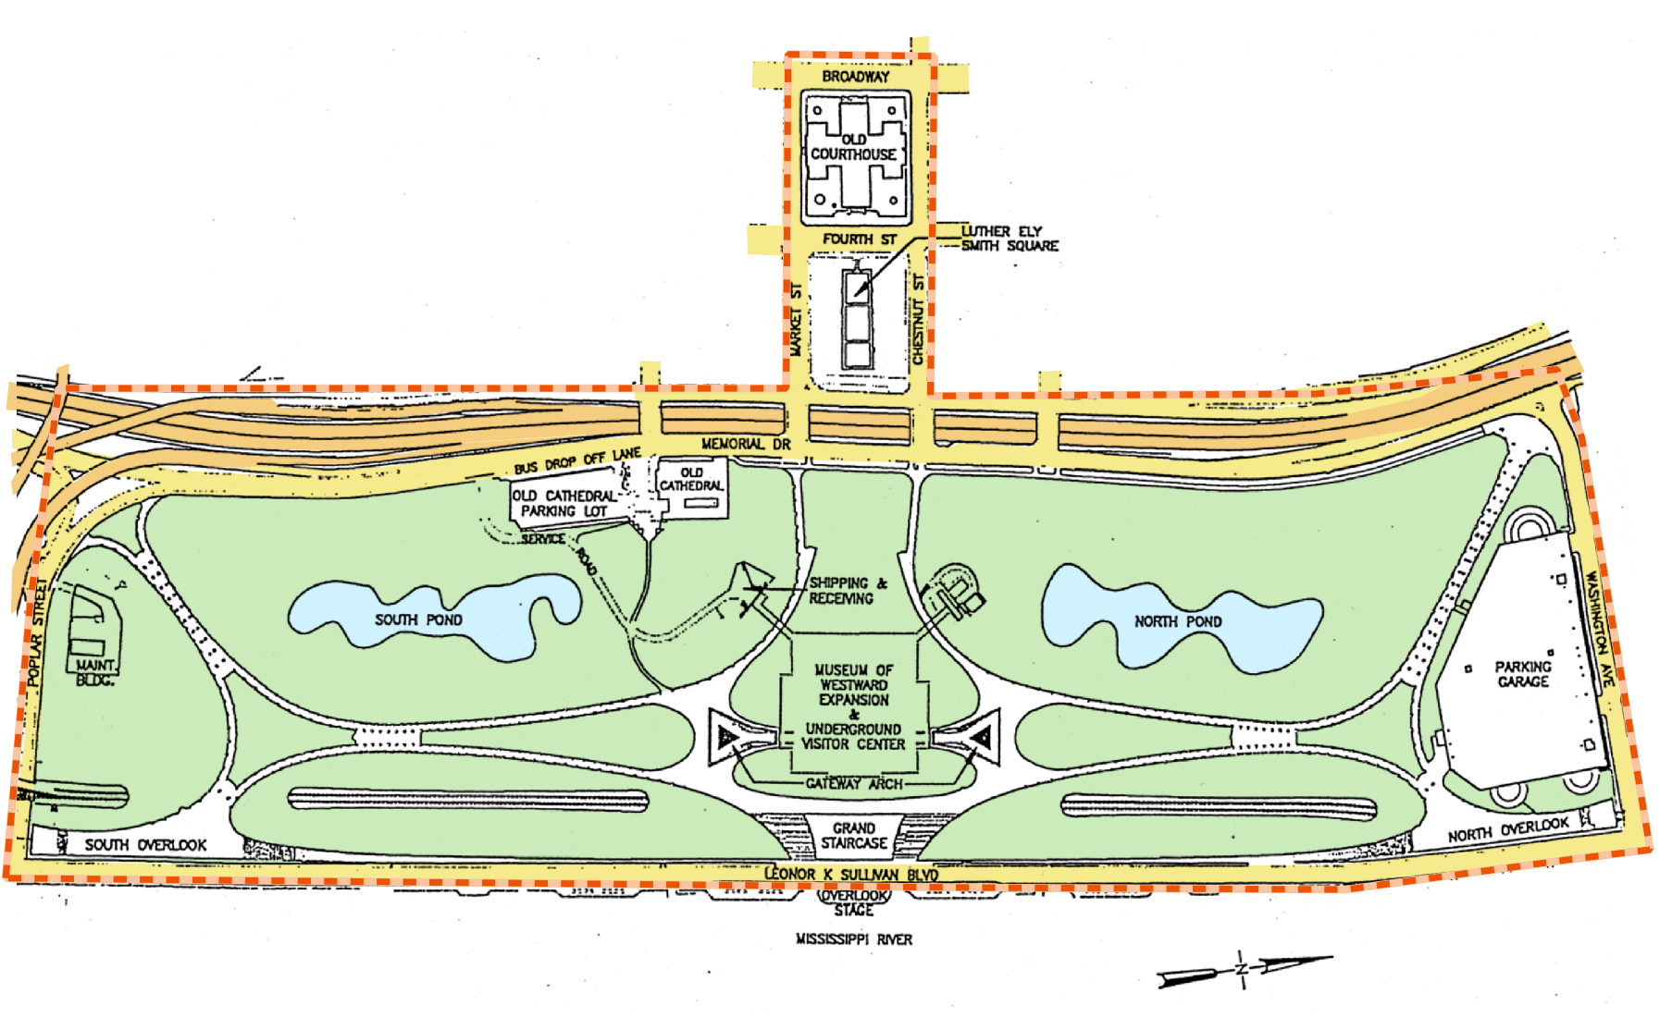

Slide 4
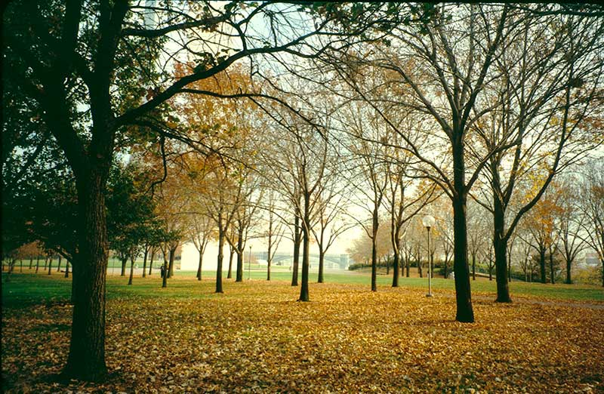

Slide 5
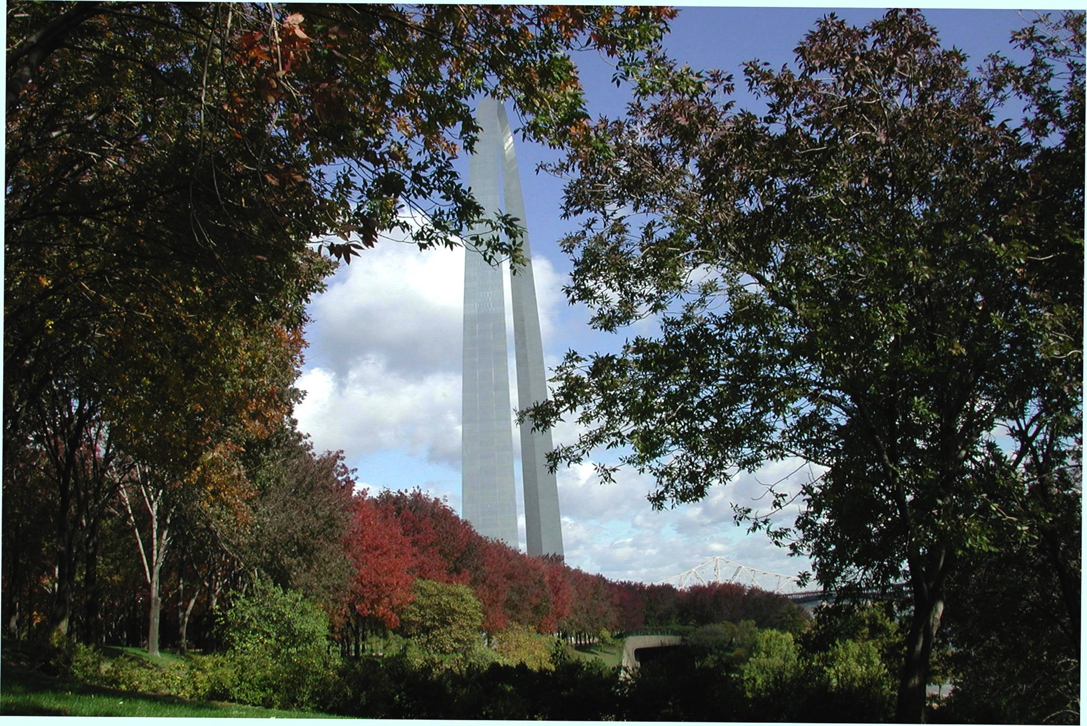

Slide 6
The Miller Garden
1955
Columbus, Indiana
The Office of Dan Kiley

Slide 7
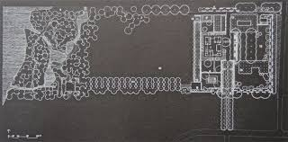

Slide 8
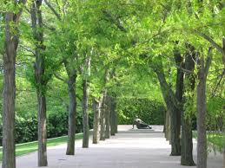
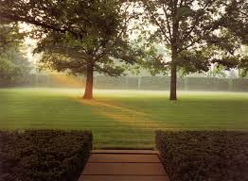

Slide 9
Pattern Garden (du Pont residence)
1998
Wilmington, Delaware
The Office of Dan Kiley

Slide 10
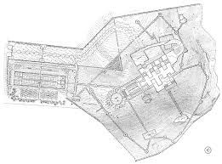

Slide 12
Citation
Memorial
commons.wikimedia.org
Photo by Charles Birnbaum, 1999
www.nps.gov
Miller
www.donaldpell.com
www.huffingtonpost.com
tclf.org
Patterns
www.washingtonpost.com
tclf.org
tclf.org

